Slide 1


Account Sales Data Analysis

Slide 2
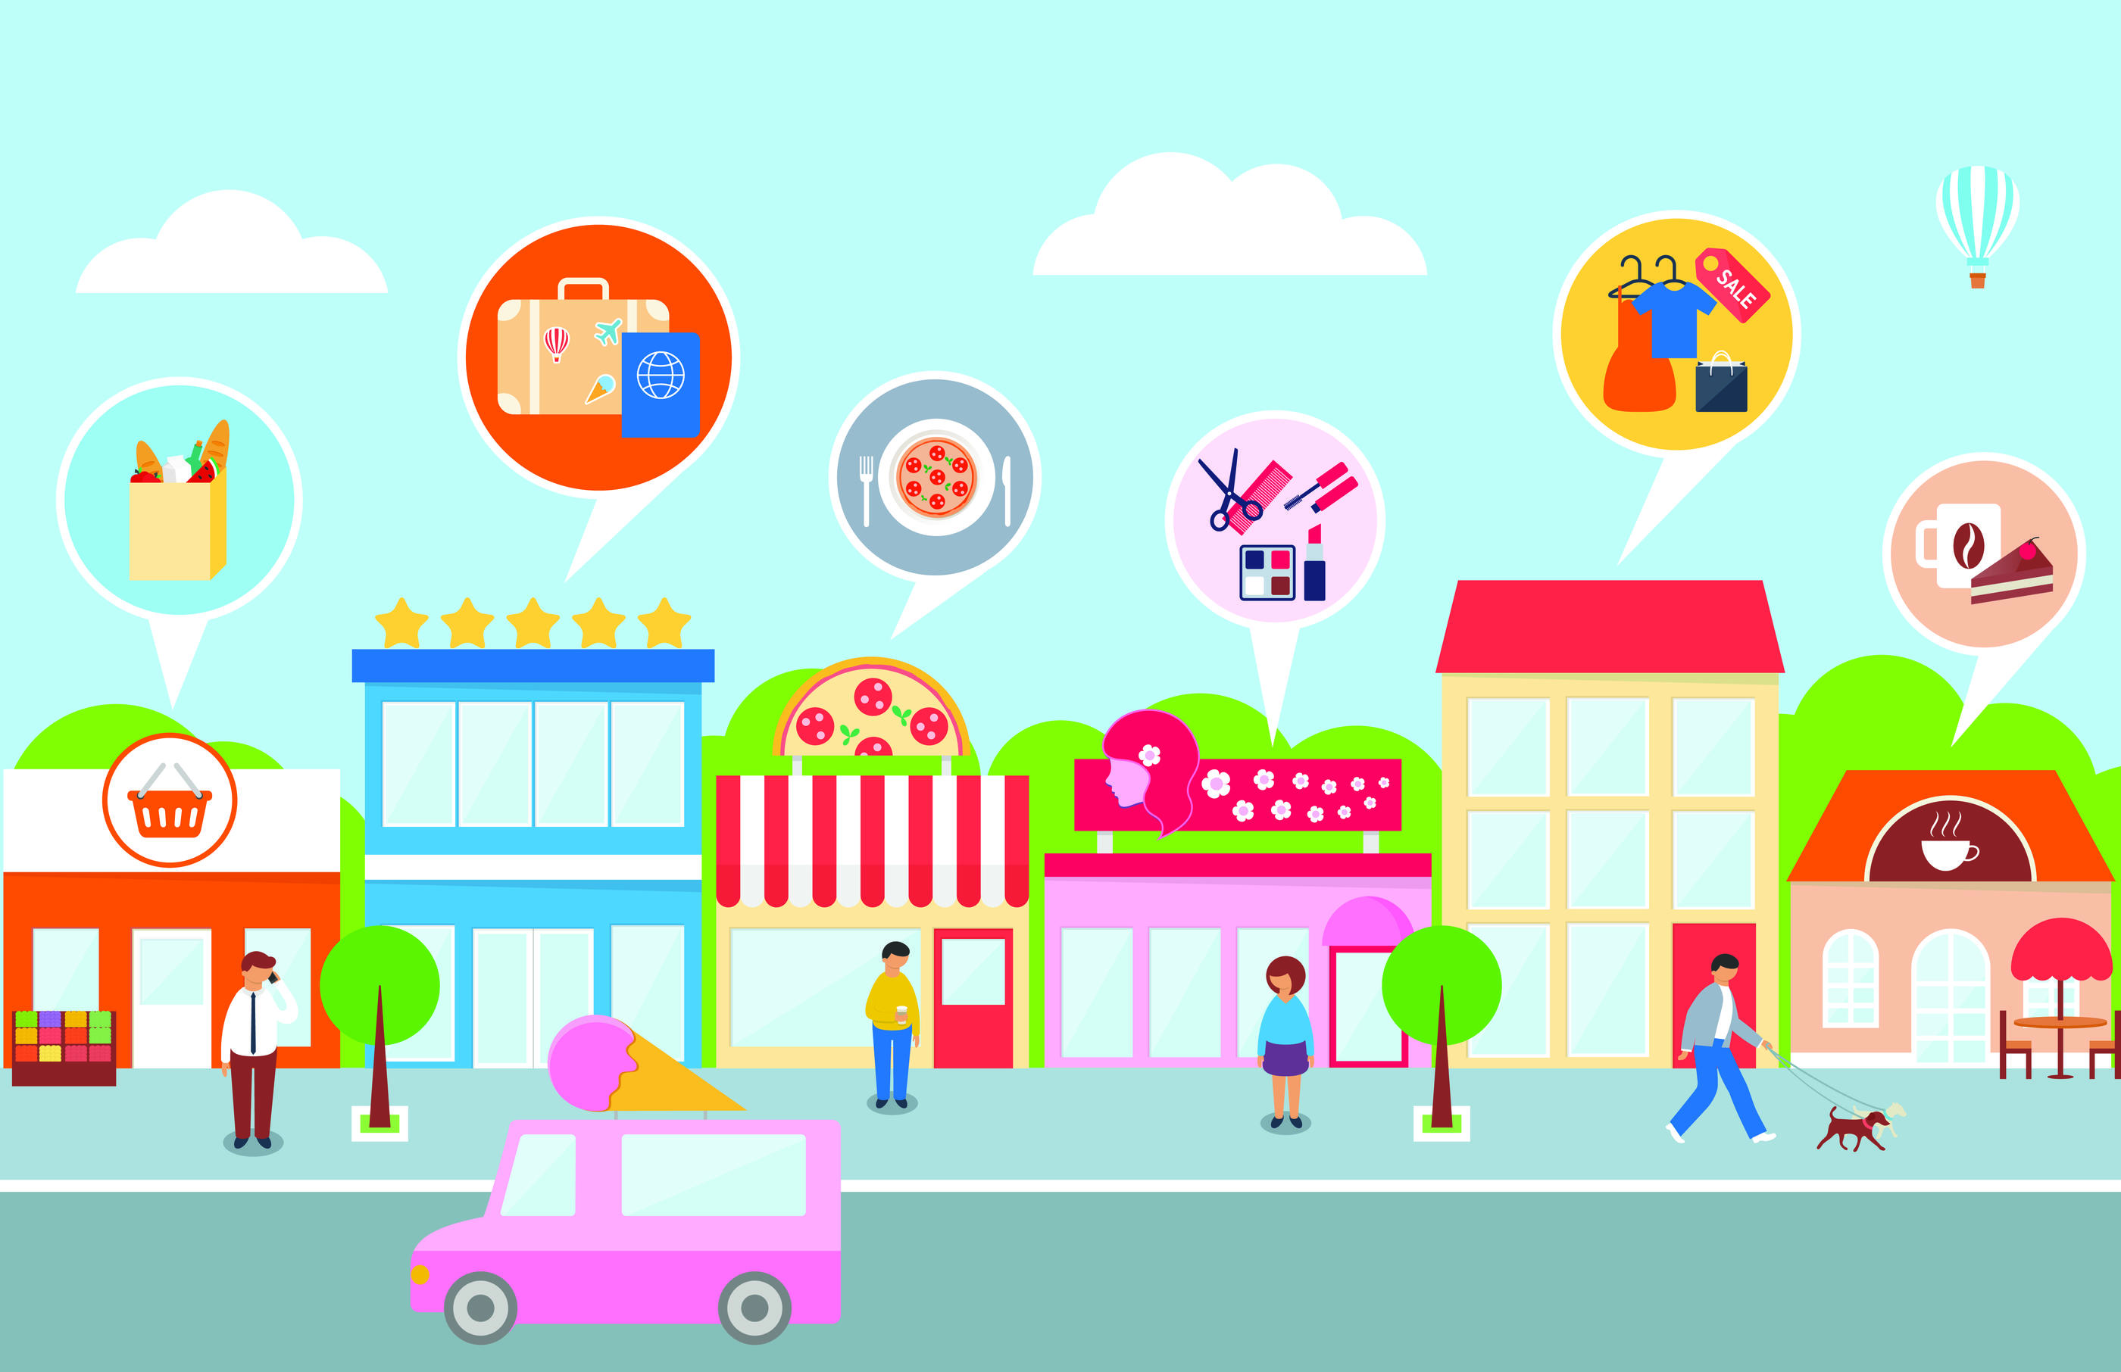
The story of businesses

Slide 3
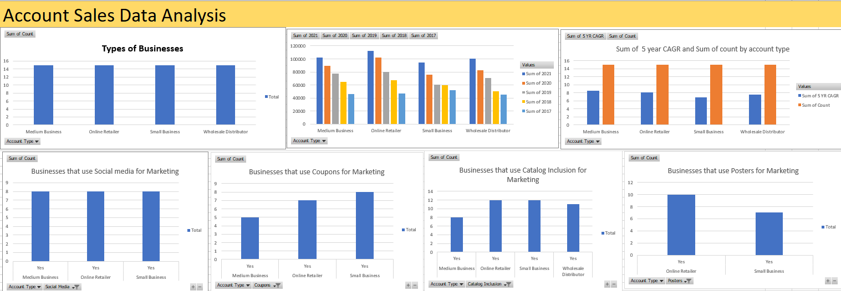

Slide 4
Key points:
4 types of businesses:
1. Medium Business
2. Online Retailer
3. Small Business
4. Wholesale Distributor
Online retailer sales in high in 2021 while Small business sales is least.
Most improvement was made by Online retailers throughout the years.
Online retailers are using all kinds of marketing/promotions strategies while the rest are selective regarding their marketing strategies.

Slide 5
Summary
Online businesses are improving consistently over the years through marketing. Therefore, other businesses, especially small businesses, should also plan marketing strategies to up their game.

